Slide 1


CREDIT CARD MISUSE
: A THREAT TO FINANCIAL STABILITY
VISIONARY CODERS

Slide 2

PROBLEM STATEMENT :
"My uncle struggles with credit card overspending have led to painful consequences. Excessive EMIs, exhausted salaries and declined cards have culminated in financial crisis. This distress has further worst harmful habits, such as excessive drinking, severely impacting his health. As a concerned daughter-in-law, I aim to address this critical issue and develop an innovative solution to control his credit card misuse, ensuring financial stability and well-being."

Slide 3
SOLUTION OVERVIEW:
Switch to Credit Card : If monthly expenditure exceeds the monthly salary, the user switches to using their credit card for payments.
Credit Limit Management : The user can spend using the credit card, but when the balance approaches 20% of the card limit, their account is freezed to prevent further spending.
Family Notification for 20% Usage : During registration, the user provides a family member’s Information. If the user have an emergency to use the remaining 20% of the credit limit, a notification is sent to the family member. The family member can either accept or reject the request for using the remaining credit depending on the concern.
Investment Option : If the user’s monthly salary exceeds their expenditure, they are presented with an option to invest the excess salary. The user can choose how much of the excess salary in percentage they want to invest.

Slide 4
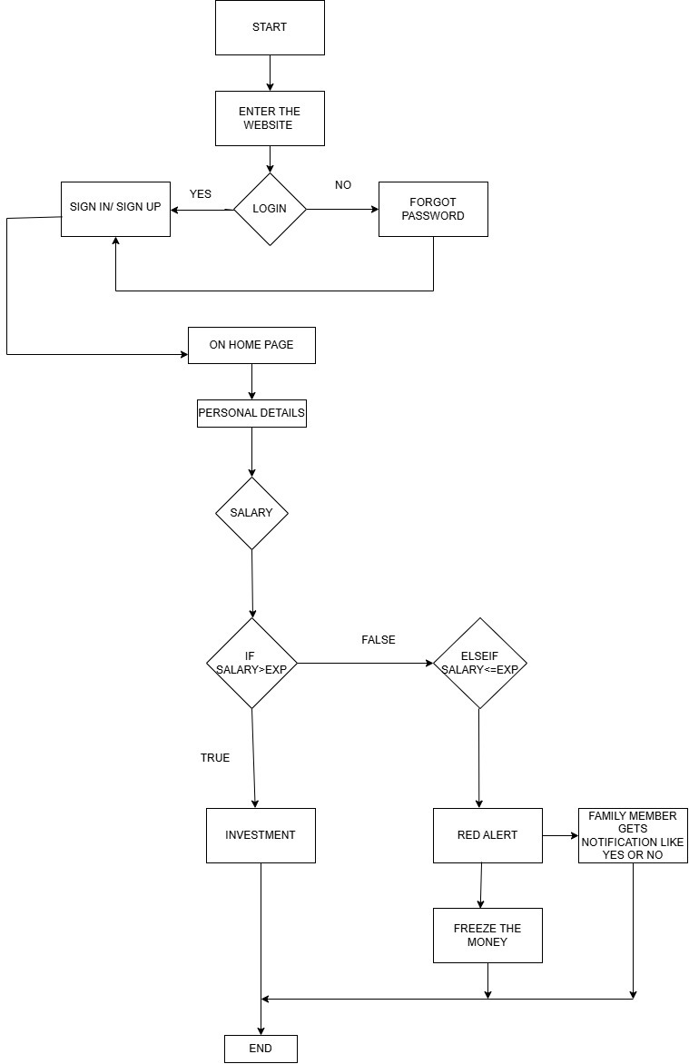
TECHNICAL ARCHITECTURE
Flowchart :

Slide 5
TECHNICAL ARCHITECTURE
Tech stack :
Frontend Technologies: Html, CSS, JavaScript, React
Backend Technologies: FastAPI, Python, JWT
Database: My SQL
Other Tools : Twilio , Docker , GitHub

Slide 6
SCALABILITY AND FUTURE SCOPE :
1. Switch to Credit Card :
Transaction Handling: As the user base grows, the system must efficiently manage a larger volume of transactions. This could involve optimizing backend processes to ensure that credit card transactions are processed quickly and securely.
2. Credit Limit Management:
Real-Time Monitoring: The system needs to efficiently monitor credit card usage and balances in real-time as more users engage with the feature. This may require scaling the database and server resources to handle increased data load.
3. Family Notification for 20% Usage:
Notification System: Implementing a scalable notification system (e.g., using third-party services like Twilio or SendGrid) allows for handling an increasing number of notifications as the user base expands.
Concurrent Requests: The backend must efficiently manage simultaneous notification requests, ensuring family members receive alerts without delays
4. Investment Option:
User Decision Management: As the number of users increases, the system should effectively manage the options presented for investment, including tracking which investments users are interested in.

Slide 7
FEASIBILITY :
Switch to Credit Card:
User Acceptance: Assess whether users are willing to adopt credit card usage management. This can be evaluated through surveys or user testing.
Integration with Financial Institutions: Feasibility may depend on partnerships with credit card companies or financial institutions for secure transaction processing.
2. Credit Limit Management:
Technical Complexity: Implementing a robust system to freeze accounts based on credit limits requires careful planning to ensure accuracy and user satisfaction.
User Awareness: Users need to be educated about how their credit limits work and the consequences of account freezing, which could impact acceptance rates.
3. Family Notification for 20% Usage:
Data Privacy: Ensure that handling family member contact information complies with data protection regulations, This will impact the feasibility of implementing this feature.
User Trust: Users must trust that notifications are sent securely and that their family's consent is respected, which could affect feature adoption.
4. Investment Option:
Market Research: Conduct research to understand user interest in investment options and the types of investments they prefer.

Slide 8

Team Details

Slide 9




MANASVI PASALA
M. AASHRITHA REDDY
STUDENT
VIT-AP UNIVERSITY
STUDENT
VIT-AP UNIVERSITY
K. AMULYA VAJRA
CH. AMITHA
STUDENT
VIT-AP UNIVERSITY
STUDENT
VIT-AP UNIVERSITY

Slide 10

THANK YOU

